Slide 1
Interfaces

Slide 2
Interfaces
Java expands on the concept of abstract methods with interfaces.
It’s often desirable to specify a group of abstract methods that define some behavior for an object without tying it to any implementation at all.
In Java, this is called an interface. An interface defines a set of methods that a class must implement.
A class in Java can declare that it implements an interface if it implements the required methods.
Unlike extending an abstract class, a class implementing an interface doesn’t have to inherit from any particular part of the inheritance hierarchy or use a particular implementation.

Slide 3
What do Interfaces Provide?
An interface is a list of methods that define some set of behavior for an object. They let you specify what should be done, without having to provide an implementation.
Any class that implements each method listed in the interface can declare at compile time that it implements the interface
Interface types act like class types. You can declare variables to be of an interface type, you can declare arguments of methods to accept interface types, and you can specify that the return type of a method is an interface type.

Slide 4
Declaring an Interface
You define an interface with the interface keyword, and list its methods with no bodies, just prototypes (signatures).
It’s acceptable, but not necessary, to declare the methods in an interface with the abstract modifier.
More importantly, the methods of an interface are always considered public, and you can optionally declare them as so.
Why public? Well, the user of the interface wouldn’t necessarily be able to see them otherwise, and interfaces are generally intended to describe the behavior of an object, not its implementation.

Slide 5
Interfaces with Implementation
Beginning with JDK 9, an interface can include private methods. Thus, it is now possible for interface to specify some behavior.
However, such methods constitute what are, in essence, special-use features, and the original intent behind interface still remains. Therefore, as a general rule, you will still often create and use interfaces in which no use is made of these new features.

Slide 6
Three Common Java Library Interfaces
The ActionListener interface : java.awt.event.eventListener
The Comparable Interface: java.lang
The Cloneable Interface: java.lang

Slide 7
The ActionListener Interface
This interface is implemented in event-driven programming. We will see a lot of it.
public interface ActionListener extends EventListener
{
void actionPerformed(ActionEvent e) ;
}

Slide 8
The Comparable Interface
This interface is used, for instance, to sort arrays of custom objects. If objects are not comparable, they cannot be sorted. The compareTo method allows the programmer to specify how to compare objects of a type.
public interface Comparable<E> {
public int compareTo(E o);
}

Slide 9
The Cloneable Interface
A class that implements the Cloneable interface is marked cloneable, and its objects can be cloned using the clone() method defined in the Object class.
public interface Cloneable {
}
It does not contain constants or methods.
It is used to denote that a class possesses certain desirable properties. A Marker Interface is an empty interface.
Cloneable is a Marker Interface.

Slide 10
Example of a user-defined Interface
interface Driveable {
boolean startEngine();
void stopEngine();
float accelerate( float acc );
boolean turn( Direction dir );
}

Slide 11
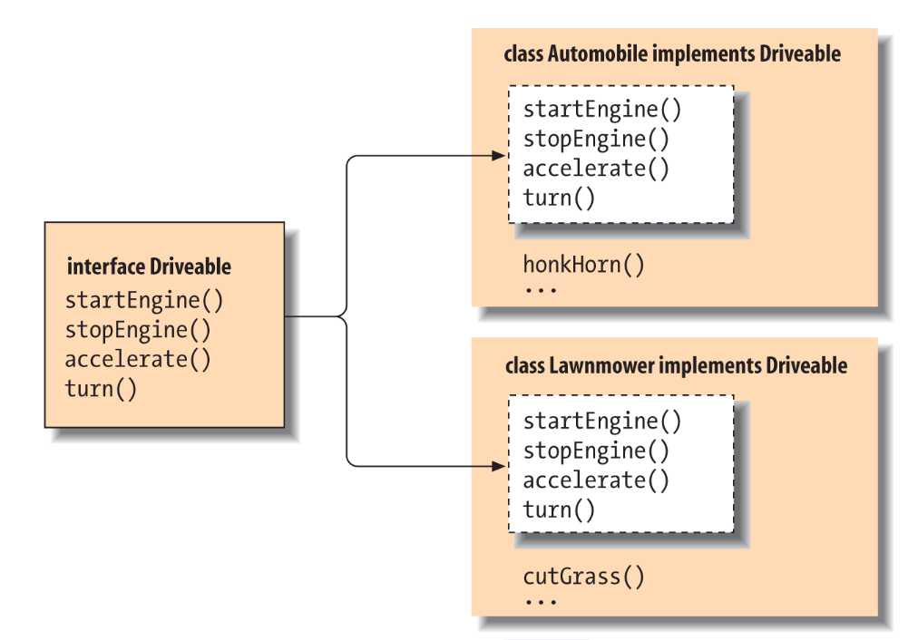
Example of Two Implementations of the Drivable Interface

Slide 12
Implementing an Interface
The implementing class must declare the methods of the interface as public.
Otherwise, they would default to package access. Since the interface requires public access, the compiler would report an error.
Let’s use another Interface:
public interface AnimalBehavior {
String eat();
String communicate();
String breathe();
}

Slide 13
Implement the Interface
public class Person implements AnimalBehavior {
public String eat() {
return “Three squares a day”;
}
public String communicate() {
return “Cell phones, of course”;
}
public String breathe() {
return “Deep breathe really using our lungs!”;
}
}

Slide 14
Implement the Interface
public class Shark implements AnimalBehavior {
public String eat() {
return “Smaller fish whenever I can find them”;
}
public String communicate() {
return “Sharks communicate with each other by the electroreception method, they bear a special type of organ called Ampullae of Lorenzini which detects the electric field, vibrations or small movement made by other animals near them and become alert.”;
}
public String breathe() {
return “Water moving over our gills is how we breathe”;
}
}

Slide 15
Inheritance vs. Interface?
In general, a strong is-a relationship that clearly describes a parent-child relationship should be modeled using inheritance with classes.
For example, a staff member is a person.
A weak is-a relationship, also known as an is-kind-of relationship, indicates that an object possesses a certain property and can be modeled using interfaces.
For example, all strings are comparable, so the String class implements the Comparable interface.

Slide 16
User Interface Callbacks
In a graphical user interface, you have to specify actions to be carried out when the user clicks a button, selects a menu option, drags a slider, and so on.
These actions are often called callbacks because some code gets called back when a user action occurs.
In Java-based GUI libraries, interfaces are used for callbacks. For example, in the Swing library, the following interface is frequently used for handling events:
public interface ActionListener {
void actionPerformed(ActionEvent event);
}

Slide 17
Accessing Implementations Through Interface References
Similar to abstract classes, you can declare variables as object references that use an interface rather than a class type. Any instance of any class that implements the declared interface can be referred to by such a variable.
When you call a method through one of these references, the correct version will be called based on the actual instance of the interface being referred to. This is one of the key features of interfaces.
The method to be executed is looked up dynamically at run time, allowing classes to be created later than the code that calls methods on them. The calling code can dispatch through an interface without having to know anything about the “callee.”

Slide 18
Variables in Interfaces
You can use interfaces to import shared constants into multiple classes by simply declaring an interface that contains variables that are initialized to the desired values.
When you implement that interface in a class, all of those variable names will be in scope as constants.
If an interface contains no methods, then any class that includes such an interface doesn’t actually implement anything. It is as if that class were importing the constant fields into the class name space as final variables.

Slide 19
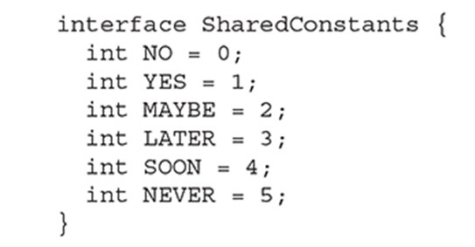
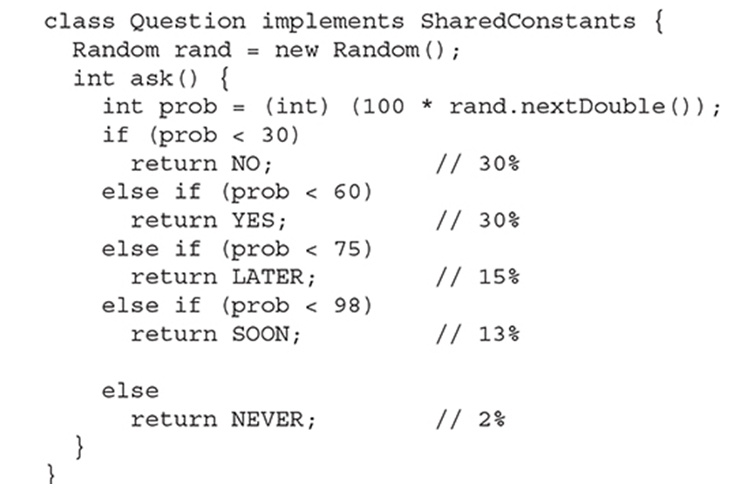
Example of Interfaces with Variables

Slide 20
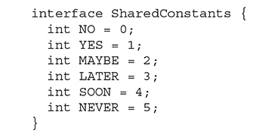

Example of Interfaces with Variables
NOTE The technique of using an interface to define shared constants, as just described, is controversial. It is described here for completeness.

Slide 21
Interfaces can be Extended
One interface can inherit another by use of the keyword extends. The syntax is the same as for inheriting classes.
When a class implements an interface that inherits another interface, it must provide implementations for all methods required by the interface inheritance chain.

Slide 22
Example of Extending Interfaces
//One interface can extend another
interface A {
void method1();
void method2();
}
//B now adds method3()
interface B extends A {
void method3();
}
//B now includes all three methods
This class must implement all of A and B
class MyClass implements B {
public void method1() {
//implement method1
}
public void method2() {
//implement method2
}
public void method3() {
//implement method3
}
}

Slide 23
Static Methods in an Interface
Another capability added to interface by JDK 8 is the ability to define one or more static methods.
Like static methods in a class, a static method defined by an interface can be called independently of any object.
Thus, no implementation of the interface is necessary, and no instance of the interface is required, in order to call a static method.
Instead, a static method is called by specifying the interface name, followed by a period, followed by the method name.

Slide 24
Example of a Static Method
public interface MyIF {
int getNumber();
//this is a static interface method
static int getDefaultNumber() {
return 0;
}
//Call getDefaultNumber() this way:
int defNum = MyIF.getDefaultNumber();

